Slide 1
NEURAL PROGRAM REPAIR BY JOINTLY LEARNING TO LOCALIZE AND REPAIR
ICLR 2019
Marko Vasic , Aditya Kanade , Petros Maniatis , David Bieber ,
Rishabh Singh
2020-05-20
JuHyoung Kim
kjhkjh75@naver.com

Slide 2
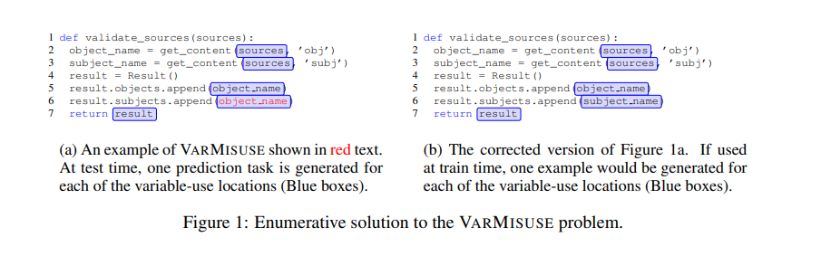
- Motivation
Advances in machine learning and the availability of large corpora of source code
Allamanis et al.(2018) proposed the problem of variable misuse(VARMISUSE)
Enumerative strategy has some key technical drawbacks.
1) Enumerating over a number of independent prediction problems
-> important shared context is lost
2) in the training, the bug is always only at the position of the slot
-> mismatch between training and test distributions hampers the prediction accuracy of the model
To deal drawbacks, Present a model that jointly learns to perform
1)classification faulty or correct program(VARMISUSE bugs)
2)Localization of the bug
3)repair of the localized bug

Slide 3
- Related work
Allamanis et al. (2018)
- Proposed an enumerative approach for solving the VARMISUSE problem using a graph neural network
Devlin et al.(2017b)
- Propose a neural model for semantic code repair
also suffers from a similar training/test data mismatch
DeepFix and SynFix
- repair syntax erros in programs using neural program representation.
Deepfix uses seq2seq model to first localize the syntax errors in C
SynFix uses a Python compiler to identify error location constraint- based search
DeepBugs
- present a learning-based approach to identifying name-based bugs.
Sk_P
- Enumerative neural program repair approach to repair student programs

Slide 4
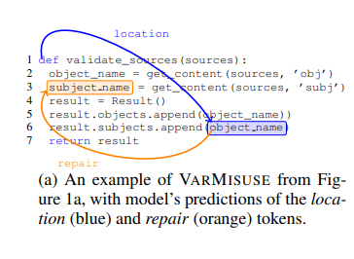
- POINTER MODELS
Use pointer-network models to perform joint prediction of both the location and repair for VARMISUSE bugs.
Encoder states are then used to train two pointers
1) first pointer corresponds to the location of the bug
2) second pointer corresponds to the location of the repair bug.
Buggy training example, capture the location of the bug and other locations where the original variable is used as the labels for the two pointers.
Bug-Free training example, the location pointer is trained to point to a special

Slide 5
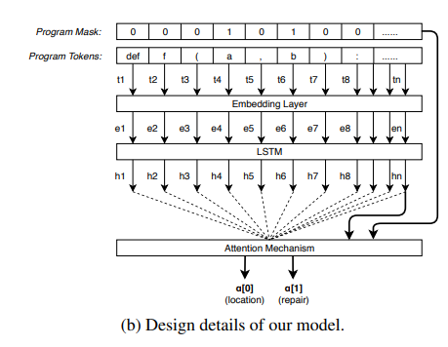

- POINTER MODELS
VARMISUSEREPAIR problem is to either predict if the program is already correct
1) the location token
2) a repair token
Variable token have binary vector with 1
Embedding matrix with LSTM
Attention matrix

Slide 6
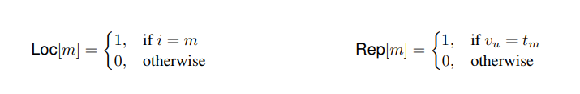
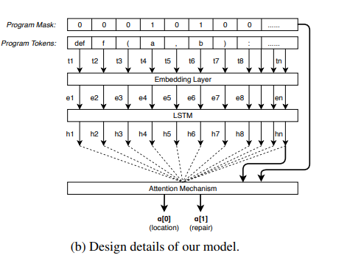

- POINTER MODELS
Non buggy programs,
Loc[0] = 1, value at all other indices is 0
- Use the following loss functions for training the location and repair pointer distributions.

Slide 7
- EVALUATION
ETH-Py150 dataset.
150K python source files(100k training 50k test)
Inputs to the enumerative model and the joint model are different
1) joint model accepts a complete program
2) enumerative model accepts a program with a hole that identifies a slot
Second dataset MSR-VarMisuse, is the public dataset used by Allamanis et al
ETH-Py150 | MSR-VarMisuse
Python | C#
Function-level scope | Entire files
Slots are variable load | Slots are variable load and store
No type information is used | Type compatible
9.26 average candidate | 3.76 average candidate

Slide 8
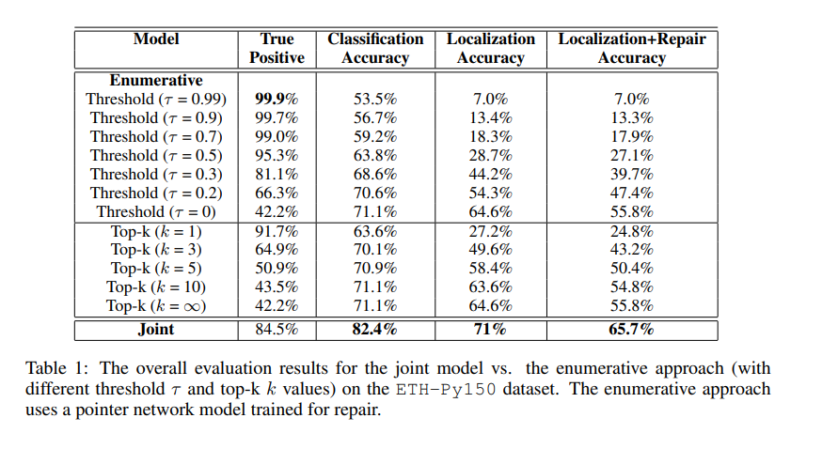
JOINT MODEL vs ENUMERATIVE APPROACH
τ : a threshold value for probabilities to decide whether to return the predictions
k: the maximum number of predictions the enumerative approach is allowed to make.
Measure metrics
1) True Positive
2) Classification Accuracy
3) Localization Accuracy
4) Localization+Repair Accuracy

Slide 9
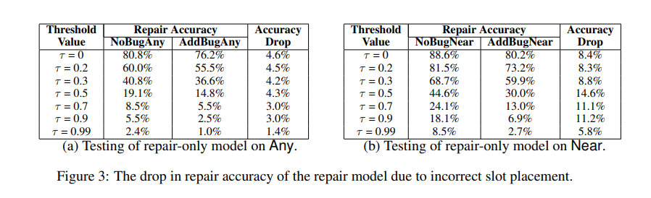
JOINT MODEL vs ENUMERATIVE APPROACH
Single repair prediction (localization and repair procedure out of it)
AddbugAny, in which the injected VARMIUSE bug is at a random location
AddBugNear,in which the injection happens within two variable-use location from the slot
NoBugAny and NoBugNear

Slide 10
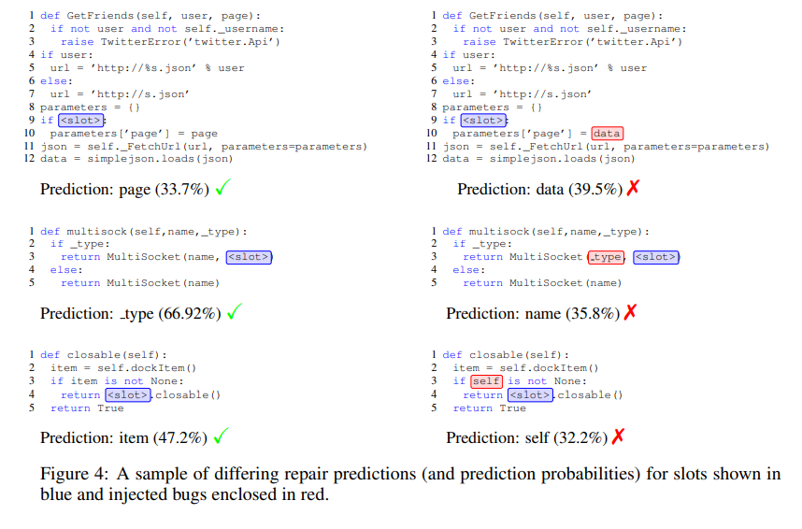
JOINT MODEL vs ENUMERATIVE APPROACH

Slide 11
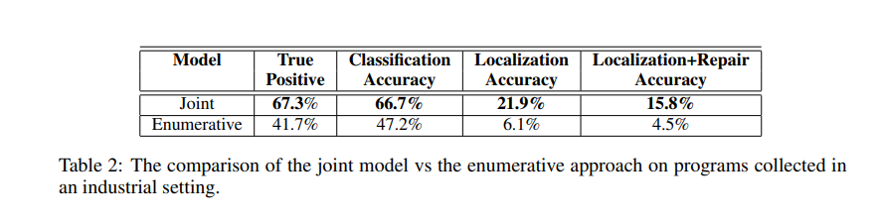
JOINT MODEL vs ENUMERATIVE APPROACH
Joint model deviates three in primary ways from that Enumerative model
1) uses a pointer network on top of an RNN encoder
2) It does separate but joint bug localization and repair rather than
using repair-only enumeratively to solve the same task,
3) it applies to syntactic program information only rather than syntax and semantics.
- In order to evaluate the model on realistic scenarios,

Slide 12
- CONCLUSION
Present an approach that jointly learns to localize and repair bugs.
Use a key insight of the VARMISUSE that both the bug and repair must exist in the original program to design a multi-headed pointer model
The joint model is shown to significantly outperform an enumerative approach
In the future, explore joint localization and repair using other models such as graph models possibly with using more semantic.

Slide 13
DeepMutation: A Neural Mutation Tool
(Proceedings 42nd ACM/IEEE International Conference on Software Engineering (ICSE 2020))
Learning How to Mutate Source Code from Bug-Fixes
(Proceedings 35th IEEE International Conference on Software Maintenance and Evolution (ICSME 2019))

